Slide 1
Good afternoon, Sir. It’s really my honor to have the opportunity for this interview. I’d like to tell you more about myself. My Chinese name is 陳文遠 and you can just call me Chris which is my English name. I’m studying in the first year of master degree at Tsing Hua University and major in Communication Engineering. When I was an undergraduate, I also majored in Communication Engineering. Although I’m not a computer science major, but my department provides many CS courses such as data structure, algorithm, computer architecture, programming ….
My topic of independent study in university is VoIP phone call monitoring platform which is to build a web application to provide VoIP phone call monitoring and management service. I use this topic to publish on domestic conference, IMP2017 and got honorable mention award from independent study competition. By the way, I also obtained a national python certificate.
My current research field is blockchain technology and I'm aimed to optimize the blockchain query speed.
I would say I’m a team player and I always be the person who resolves problems in a team. I’m especially interested in “Programming”. Since whenever I use program to figure out a problem, I get a sense of achievement from it.
I’m competitive and also have strong commitment to get any opportunity to fully play my ability. I think this job is a good choice and I can be competent for this job!!. That’s all.
Thank you for your time.
(2:09)
VoIP 網路電話監控系統
人臉識別網頁登入
Blockchain

Slide 2
Applied Materials Interview Presentation
Speaker : Wen-Yuan Chen (陳文遠)
Position : Algorithm Developer (Intern)
Date : March 25, 2020

Slide 3
INTRODUCTION

Slide 4
ABOUT
EDUCATION
 | National Tsing Hua University (GPA 4.08) Institute of Communications Engineering (MS) | Hsinchu, Taiwan Sep. 2019 – Present
 | Feng Chia University Department of Communications Engineering (BS) | Taichung, Taiwan Sep. 2014 – Jan. 2019
ACADEMIC EXPERIENCE
2018 National University Competition of Python
2017 IMP 2017 Conference
2017 Independent Study Competition
Certified
Publish
Honorable Mention Award

Slide 5
SKILLS
WHAT I HAVE DONE
Website and Server Develop | Node.js(Server), HTML, Javascript, CSS
Computer Vision | C++(or Python) with OpenCV
Network Programming | C language
Embedded System Development | C(or Python) with Raspberry PI
Communication Simulation | Matlab
Blockchain Technology | Go lang with Hyperledger
Linux (UNIX) Operation | Basic operation

Slide 6
PROJECT

Slide 7
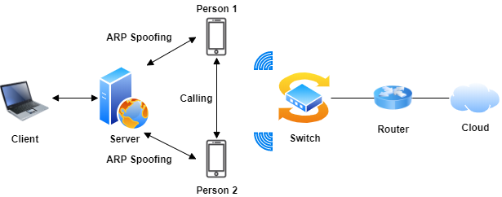
(1) VoIP Phone Call Monitoring Platform
PURPOSE
Provide VoIP phone call monitoring and management service to user.
ARCHITECTURE

Slide 8
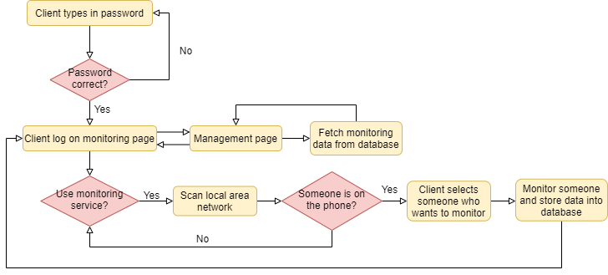
(1) VoIP Phone Call Monitoring Platform (Cont.)
FLOWCHART

Slide 9
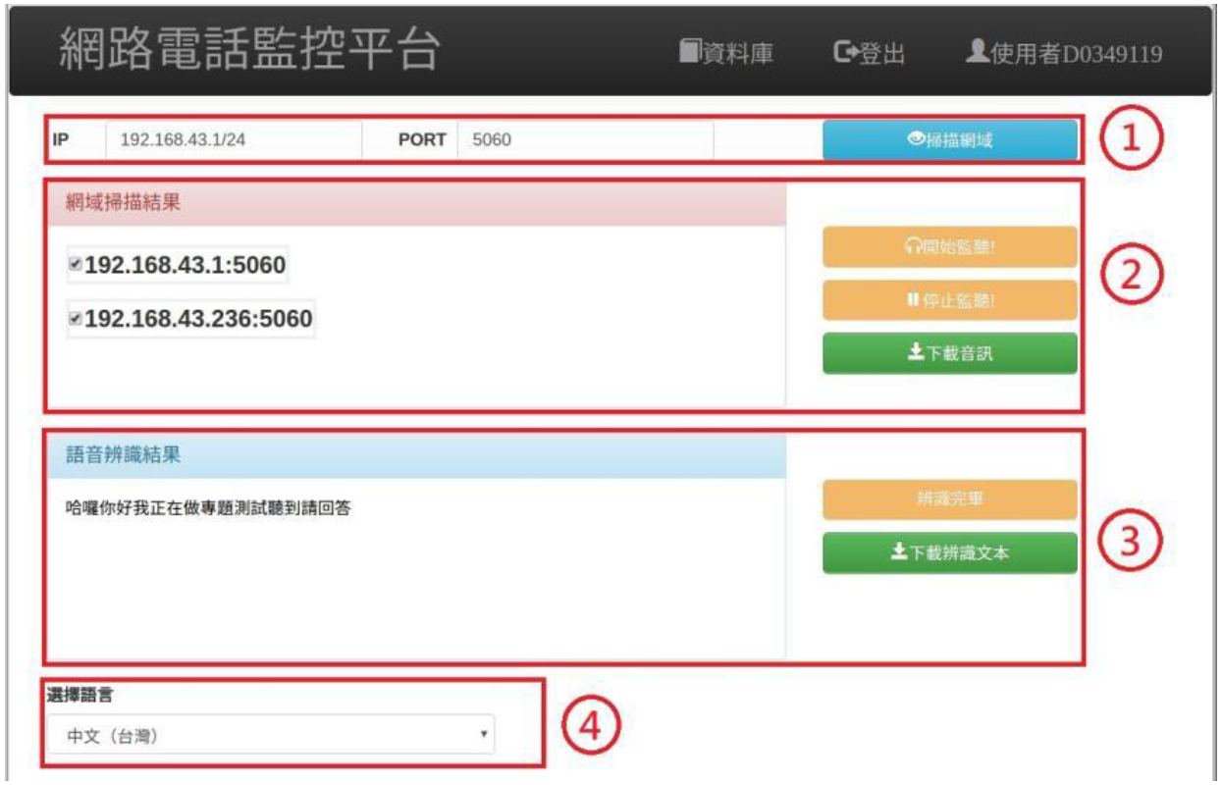
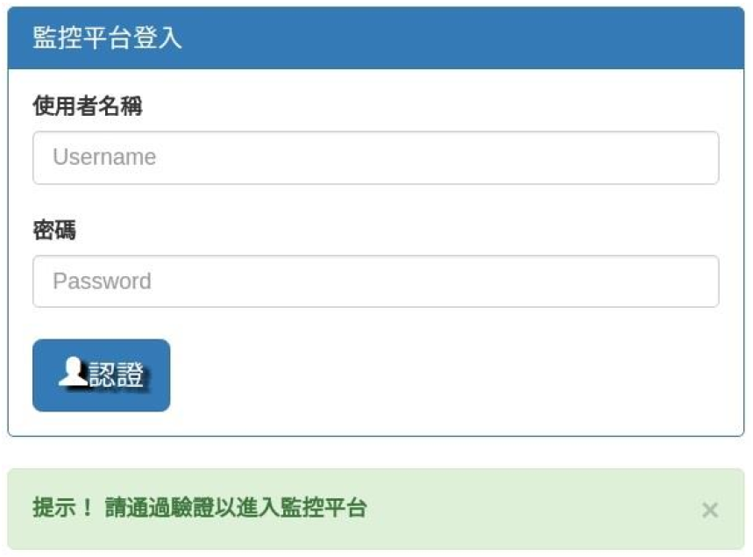
(1) VoIP Phone Call Monitoring Platform (Cont.)
RESULTS
Fig 1. Login page
Fig 2. Monitoring page

Slide 10
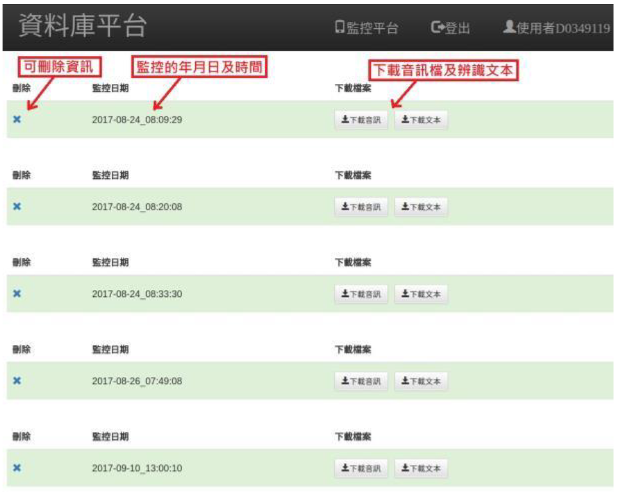
(1) VoIP Phone Call Monitoring Platform (Cont.)
RESULTS
Fig 3. Management page

Slide 11
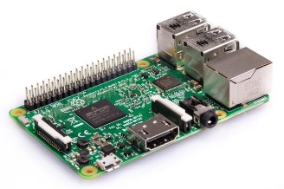
(2) Blockchain Traceability System with HyperQL
PURPOSE
Create a blockchain-based IoT system and propose an architecture, named “HyperQL”, to speed up the query speed.
ARCHITECTURE
Node
Collect data and submit to blockchain
IoT device

Slide 12
(2) Blockchain Traceability System with HyperQL (Cont.)

Slide 13
(2) Blockchain Traceability System with HyperQL (Cont.)

Slide 14
(2) Blockchain Traceability System with HyperQL (Cont.)

Slide 15
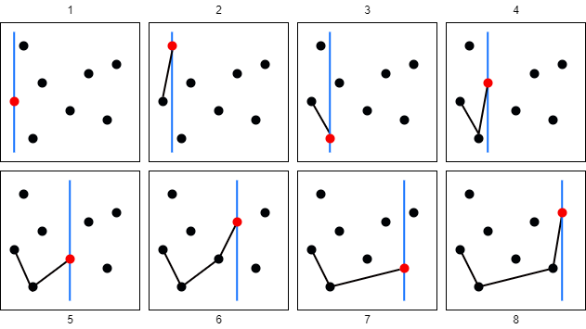
(3) Convex Hull Algorithm
PURPOSE
Learn how to solve convex hull problem.
METHOD
Andrew's Monotone Chain.

Slide 16
(3) Convex Hull Algorithm (Cont.)

Slide 17
(3) Convex Hull Algorithm (Cont.)

Slide 18
Thank you for your time

